Slide 1
A RefResher in Laboratory Statistics: Using R in Validations and Verifications
Amrom Obstfeld
November 22, 2024

Slide 2
Lesson Goals
Get oriented to R and RStudio
Learn some fundamentals of coding
Lesson Objectives
Log in and tour RStudio Cloud
Execute code at the console
Define and use functions
Define and create objects in the environment
Load data into R and interact with a dataframe
Notes:
In this first session our goal is to develop some familiarity with the R programming language as well as some basic proficiency with coding fundamentals as they are implemented in R.
We will log into the R environment and learn about the how to execute code in the console.
Upon this we will layer concepts of functions and objects. We will use some basic functions and make some objects.
Finally we will load data and interact with a dataframe.

Slide 3
Getting Oriented to R

Slide 4



R
Programming language for
data analysis
RStudio
Interactive development environment (IDE)
R Markdown
Computational document format
Notes:
I’m sure you all are excited to get started programming and we will do that in just a few minutes.
Before we do that I want to introduce you to 3 items.
The first is R. R is a programming language for data analysis. There are lots of great things about R: it is freely available, great for wrangling data, and very capable for producing impressive visualizations. There is also a great community of folks using it for data science, and we are excited to welcome you all to the R community via this course.
(**) Then, there’s RStudio. RStudio is the name of a company and also the name of a piece of software this company makes (and makes available for free). You can think of RStudio as a sophisticated text editor for writing R code. You can run RStudio on Mac or Windows, or on a server.
(**) Finally there’s R Markdown. R Markdown is a computational document format that has executable code usually written in R. I say usually because it’s actually possible to write code in python, C++, and a other languages inside of an R Markdown document. R Markdown also includes capabilities for annotating your work which is incredibly handy.
These three R’s synergize for a robust ecosystem for performing data analysis.

Slide 5
What is R?
R is a statistical programming language.
Using R you can load, analyze, and visualize data.
R also provides an environment in which we can conduct reproducible data analysis.
Documented
Revisable
Shareable
Notes:
R is a statistical programming language. It is freely available and has been evolving for > 25 years.
R is popular with statisticians and data analysts. It’s flexible, extensible, and broadly capable for the import, analysis, and visualization data.
R supports everything from linear regression to machine learning.
R also enables us to conduct reproducible analysis that we can document, iterate, and share with colleagues. R is great for those looking to graduate from working with spreadsheets.

Slide 6
RStudio: The Portal to R
RStudio is an integrated development environment (IDE)
Using RStudio we can interact with the R programming language to:
Write and execute code interactively
View data
Debug and fix errors
Author our code
Notes:
A base install of R gives us the ability to write and execute code.
However, many R users choose to leverage an integrated development environment (IDE) for their work in addition to the base install. An IDE layers over the R programming language and provides a more streamlined way for us to work with R.
The most popular R IDE is RStudio. This is the IDE we will be using in this course. RStudio is also a company (the that produces the RStudio IDE). In this course, when we say RStudio, we are referring to the IDE software.
RStudio adds many features to the basic R installation including the ability to easily view data, identify syntax (code grammar), and debug our code to fix errors.

Slide 7
RStudio: In the Cloud… In Your Home
RStudio Cloud: An online hosted version of RStudio that we will use for these course sessions
RStudio Desktop: A locally installed version of RStudio that you will use when you get home to continue your learning
Note: Use Rstudio Cloud only for this course. Do not upload protected health information to the cloud!
Notes:
For today’s course we plan to leverage RStudio Cloud. RStudio Cloud is an internet hosted version of RStudio which allowed us to prepare an environment and prepopulate it with data, code, and exercises so you don’t have to spend your energy on those pieces.
When you get home, you will likely transition to using a RStudio Desktop which is a locally installed version of RStudio. We suggested that you install the desktop version ahead of this course so you will be ready to continue to learning R when you walk out of the classroom this afternoon and as a fallback in the event that we experience technical challenges with the cloud deployment.

Slide 8
Getting Started with RStudio
Notes:
Without further ado, let’s dive in!!
Getting Started with RStudio.

Slide 9

RStudio: On the Web and In Your Home
RStudio Server
Hosted on a server
(in the cloud)
RStudio Desktop
Installed locally on your computer
Note: Use Rstudio Server only for this course. Do not upload protected health information to the cloud!
Notes:
As I just mentioned RStudio can be installed on a server or locally on your computer.
RStudio Server – a version of the RStudio IDE that can be accessed from a web browser. This is what we will use as a training environment today.
RStudio Desktop – a version of the RStudio IDE that is installed on your computer. This is what you should use after the course to continue learning R and working on R projects.
On the course website (https://github.com/amromeo/api_r2021), we included links to videos demonstrating how to complete a local install of RStudio Desktop. We also provide access to the course content via a github repository. So though the training environment is ephemeral, you will have access to the course content in the future.
One last reminder, please don’t upload any external data (and especially PHI) to the cloud!

Slide 10
Your Turn #1
Go to https://api-r.cloud in your browser and log in using the username and password provided in the course email.
Click “thumbs up” in zoom once you see the RStudio panes.
If you can’t access the site click “thumbs down” and we will set you up in a backup configuration shortly.
Notes:
Now it’s your turn to get logged into Rstudio.
Go to the site https://api-r.cloud in your browser.
Use the login credentials sent to you earlier (e.g. apir000 for login, 6 digit password).
If you don’t have your log in credentials, see the document we are posting in the chat.
Please click the yes button in zoom to let us know you logged in successfully.
We will do our best to get everyone logged in. If you are struggling to log in, please reach out in the chat and we will try to help you access the course content via an alternate method.
In a course this size, we may not be able to get every participant logged in successfully. If we aren’t able to help with your specific issue, don’t worry, follow along via the slides, the course will still be valuable for you.

Slide 11
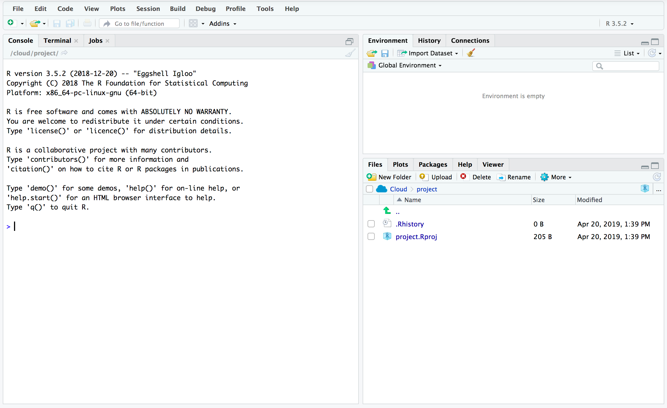
Overview of the RStudio Environment
ENVIRONMENT
CONSOLE
OUTPUT
Notes:
This is the basic RStudio layout.
Console – Where we will enter and execute the code we write in this session.
Environment – Where objects (think variables or containers for storing data) will appear.
Output – Where the output of our visualization occurs. It also has tabs for us to browse file locations and interact with the help documentation

Slide 12
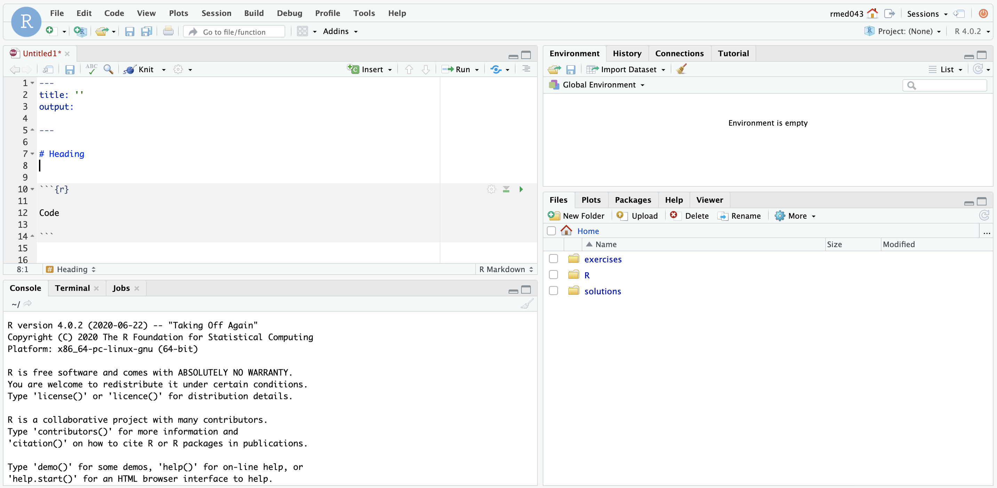
ENVIRONMENT
EDITOR
CONSOLE
MISC
Notes:
Here’s what the RStudio window looks like.
On the top left is the editor. This is where you enter code.
On the top right is the Environment. The environment allows you to look at the data that’s loaded into R. Interacting with data in the environment tab provides some of the functionality you may be familiar with from working in Excel.
The Console is on the bottom left. You can use the console quickly run an individual R command, like install a package. We won’t use the console in this course.
The pane we have labeled “MISC” has a few of tabs. The most important one for today is the “Files” tab which shows the files we’ll be using for the course.

Slide 13
R for Reproducible Data Analysis
Notes:
One of the most powerful aspects of working in the R environment is the ability to conduct reproducible data analyses (those analyses that can be shared, revised, repurposed and reproduced) by others.

Slide 14
Replication vs Reproduction
Replication: other people collect new data
Scientific gold standard
Difficult and time-consuming
Reproduction: other people analyze the same data
Does not by itself validate the analysis …
Has been proposed as a minimal standard
Notes:
Focus of learning the skills we’re teaching today isn’t strictly research
But we should define 2 terms frequently discussed in the research world: Replication and Reproduction.
Replication: other people collect new data and reach the same conclusions
This is the scientific gold standard but is also difficult and time-consuming.
Reproduction: other people analyze the same data and reach the same conclusions
Reproduction does *not* show by itself that the study is valid. There could still be problems with external validity of the conclusions, however, since it’s theoretically so much easier than going out there and doing an entirely new study, reproducibility has been proposed as a minimal standard to examine the scientific validity of the conclusions of a study.
And as the data analysis part of a study becomes more complex, reproducibility of the data analysis becomes more important.

Slide 15
18
The Duke Cancer Scandal
Chemo sensitivity from microarrays
Errors first, then cover-up
Clinical trials based on flawed models
Papers retracted, lawsuits settled
Notes:
To highlight the importance of reproducibility, let’s consider the following case.
In the mid-2000s, two researchers at Duke University tried to use microarray gene expression data of tumor cells to predict sensitivity to chemotherapeutic agents. This approach generated a lot of excitement at the time, and the resulting work was published in high-profile journals including Nature Medicine, JAMA, and the New England Journal.
(**) Unfortunately, there were a number of serious errors in the data analysis. The media has focused on the fact that the researchers tried to cover up investigations into these errors and press on towards clinical trials even though there were at the time open questions about the validity of the methods.
(**) Even more unfortunately, patients were enrolled in clinical trials and allocated based on flawed models, and in all likelihood patients were actually allocated to incorrect treatment arms.
(**) In the end, 18 papers were retracted, and Duke settled more than 10 lawsuits for an undisclosed amount of money.

Slide 16
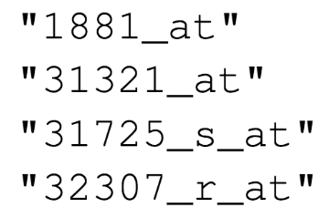
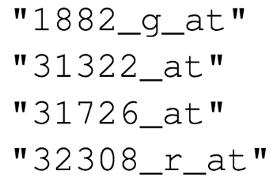

Duke
MD Anderson
Off-by-one indexing error
Notes:
Keith Baggerly and Kevin Coombes, biostatisticians at MD Anderson uncovered the mistakes that led to these retractions, in painstaking work. Let’s look at one of the errors they found.
These are a few of the hundreds of microarray probe sets – each corresponds to a gene – that the Duke investigators reported to predict sensitivity to 5-fluorouracil.
(**) And here are the probe sets that the MD Anderson team got. You can see that those two are different.
(**) If I highlight the last number of each probe, you might notice a pattern: the number of the probe set that Duke reported is exactly one less than the number of the probe that MD Anderson found when they re-did the analysis.
(**) This is what’s called a off-by-one indexing error and is what happens when you use a tool like Excel and accidentally delete one cell. The result is that all the values in the affected column are shifted by one. This is a simple error to make, but as you might imagine, this error invalidates all downstream results.

Slide 17
“Common problems are simple…
Off-by-one indexing error
Sensitive / resistant label reversal
Confounding in experimental design
Inclusion of data from non-reported sources
Wrong figure shown
… and simple problems are common.”
Notes:
The off-by-one indexing error was just one of many simple errors the MD Anderson team discovered.
(**) Another type of error that was pervasive in the study was label reversal so that cell lines were labeled sensitive to a drug when they actually were resistant, and vice versa. That type of error can lead to a scenario where a patient gets the chemotherapy that would be predicted to be least beneficial.
(**) Other problems they identified were confounding, (**) inclusion of data from sources that were not reported in the paper, (**) and wrong figure shown.
These are all simple errors – you don’t have to be incompetent or negligent to make them. (**) Because these errors are so easy to make and because without good documentation or a reproducible workflow it’s hard to catch them, they are also very common.

Slide 18
Point-and-click is not reproducible
Computer code can precisely document each step of the analysis
Notes:
A key issue in this case study is that the investigators used “point and click” tools like Excel.
This prevented peers and independent investigators from catching errors in the analysis, until it was too late.
And the Duke case study is only one example where the critical barrier to reproducibility was the tendency of investigators to use graphical user interface “point-and-click” type tools. These interactive tools usually don’t record user actions and because of this, they are fundamentally not reproducible.

Slide 19
Why YOU should analyze your data reproducibly
“Can we redo the analysis with this month’s data?”
“Why do the data in Table 1 not seem to agree with Figure 2?”
“Why did I decide to omit these six samples from my analysis?”
Your closest collaborator is You from 6 months ago
Notes:
But reproducibility doesn’t only help others. Consider the following 3 statements and ask yourself if they sound familiar.
-Can we redo the analysis with this month’s data?
-Why do the data in Table 1 not seem to agree with Figure 2?
-Why did I decide to omit these six samples from my analysis?
**Your closest collaborator is you from 6 months ago. You can do yourself a huge favor by using tools that promote reproducibility.
And if you are analyzing clinical data and might affect patient management or public health based on your findings, that makes it so much more important that you take steps to assure your analysis is documented, free of errors, and reproducible by others.

Slide 20
Using R for Reproducibility
Programming in R (or another language) allows one to reproduce analysis steps exactly or perform same analysis on new data
Better practice is to create documentation about analysis to accompany and explain code
Best practice is include documentation and code in one place

Slide 21
Notes:
R Markdown provides us with features and tools to tackle the reproducibility problem.
In R Markdown, we can craft computer code mixed in with narrative annotation that documents the purpose of the code and details about the decisions we made in our analysis.
R Markdown provides a lab notebook interface for analysis, visualization, and annotation of our work.
It is quickly becoming the gold standard for reproducible data analysis. In the course we will teach you to use R Markdown and we encourage you to continue using it consistently in your future work. In fact, it is the strongest recommendation we will make to you today.

Slide 22
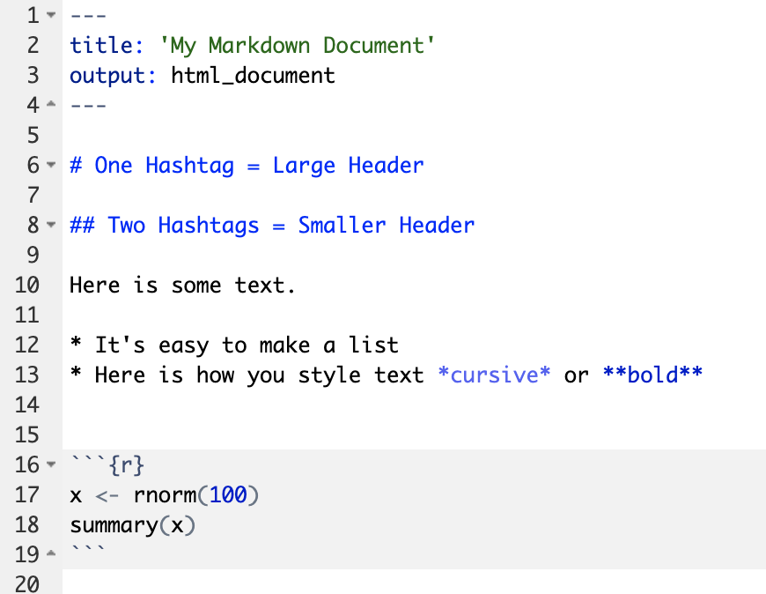
Anatomy of an R Markdown Document
Header
Header
Text (with marks)
Code chunk
Notes:
R Markdown documents are composed of 3 basic building blocks.
**The first is the Header which includes pieces like the name of the document, the document’s author, and the desired output format when the document is assembled.
**The second block is the text. R Markdown documents can be marked in ways that promote readability with various formatting styles.
**Finally, there are code chunks. Code chunks include include R code that can be executed to output results.

Slide 23
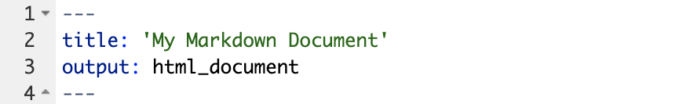
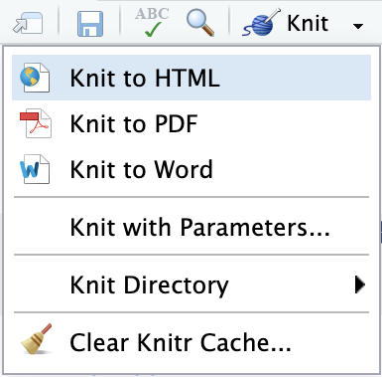
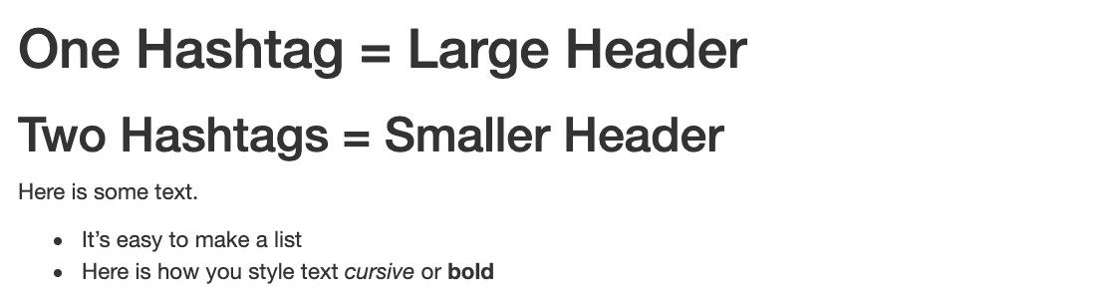
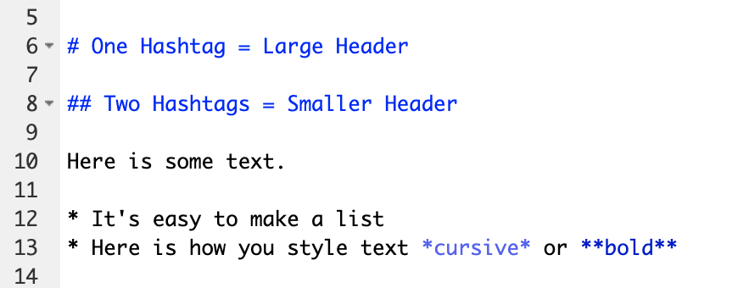
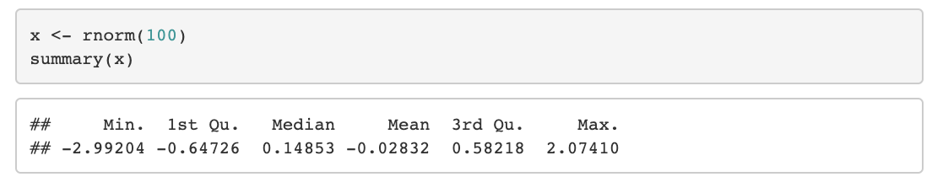
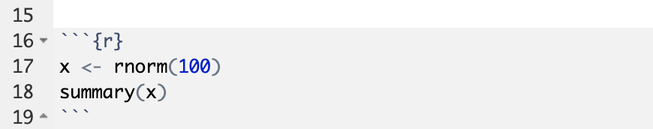
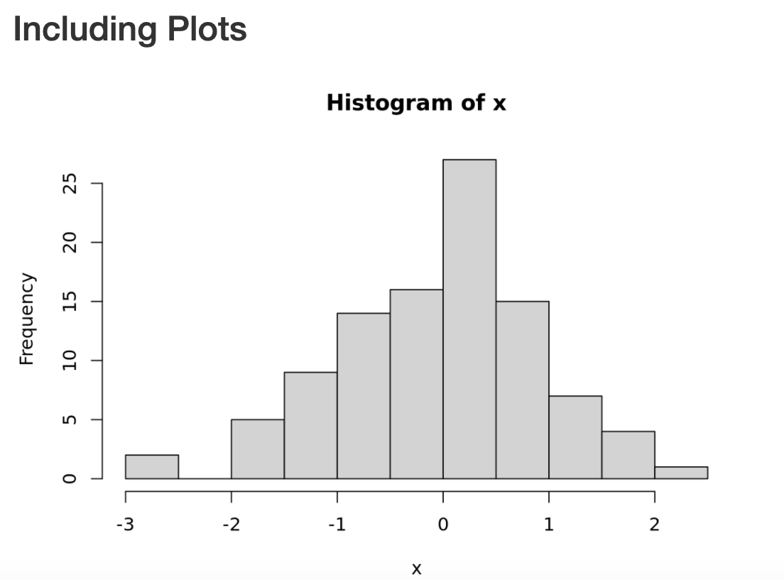
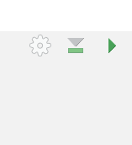
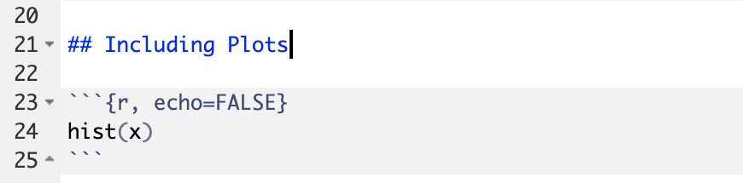
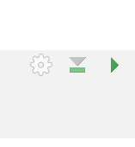
Notes:
Within the R Markdown document, we can execute a single code chunk by ** clicking the “Run Code Chunk” arrow.
And with the click of a button ** (called knitting), we can turn a R Markdown document from this ** to this.

Slide 24
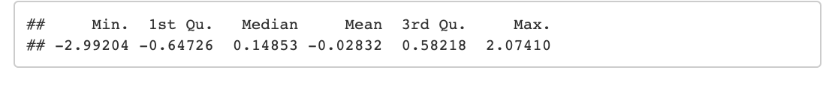
Notes:
Let’s look at this R Markdown document in greater detail.
Again the first block is header section
** The second block includes narrative text with styling applied.
** Then we get to the code chunks (shown in gray boxes). Don’t worry about the grammar of these particular code chunks at this point. In brief the first code chunk generates 100 normally distributed values which are performing a summary on. The knitted document shows us our code ** and the output of that code.
** The second code chunk renders a histogram visualization of that data.
The result is a neatly formatted document that includes an annotated description of our analysis, the code we used, and the output of that code.

Slide 25
Your Turn #2
Open a sample R Markdown document (File -> New File -> R Markdown).
Review the format of the document: header, text, code chunks
Execute the individual code chunks by selecting the Run Current Chunk arrow.
Knit the document to HTML (Preview or Knit Button -> Knit to HTML). You may be prompted to save your R Markdown first. In this case select a name for your document and click save. Review the knitted document.
Notes:
It’s your turn again.
Follow the instructions in Your Turn #2 to
-open an R Mardown document
-review the format
-execute individual code chunks
-knit the document
We will meet back in 3 minutes to review this exercise together.

Slide 26
The Basics of Coding

Slide 27
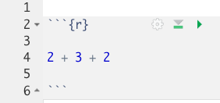
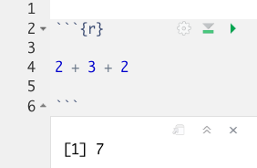

The Basics of Coding: Calculation
press play button to execute code
R is a calculator!
result returned here
Notes:
At it’s most basic, R is a fancy calculator.
It supports common mathematical operators
+ add, - subtract
* multiply, / divide
^ exponents
When we execute our code by pressing the play button, the answer is returned below the code chunk.

Slide 28
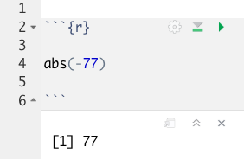
The Basics of Coding: Functions
Code that extends our reach beyond the basic operators
function
(does stuff)
argument
(input)
abs(-77 )
Notes:
Functions are code that perform actions on our behalf. We can use functions that others have written (or that we write ourselves) to reuse existing code over and over.
Functions accept an argument (input). We use parentheses as the syntax (grammar) to identify the argument(s).
Then the function does its task and provides us with some output, in this case the absolute value of an integer.

Slide 29
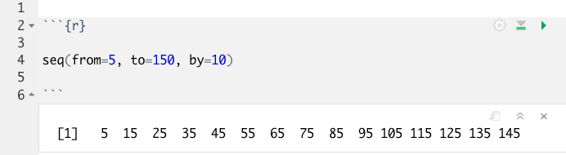
Putting Functions to Work
We can use functions to do more than simple math, we can make things!
We can create a series of integers (a vector) using the seq() function
Notes:
Functions can do more than simple math.
In this case the sequence function seq() accepts arguments defining a start position, a stop position, and an interval, to create a series (a vector) of integers.

Slide 30
The Basics of Coding: Objects
Objects are the container for your output
object
(stores output)
function
(does stuff)
arguments
(input)
sequence_of_10s <- seq(from=5, to=150, by=10 )
Notes:
Objects are a very important concept in many programming language.
Objects are the containers in which we can store things for later use.
You can store single values, series, tables, or even text.
In this example we are taking our previous seq() created series and storing it out to an object which we have called sequence_of_10s.
The <- characters are called an assignment operator. They point to the place where we want to store output.
You can execute code without assigning it to an object however the output is not stored for future use. If you want to revisit or reference the output of a particular line of code, assign it to an object using the assignment operator <-

Slide 31
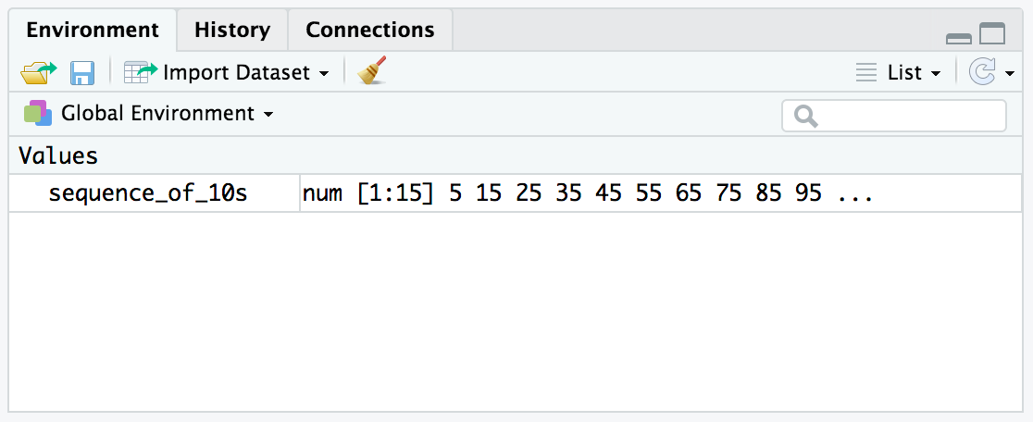
Checking the contents of an object
The environment tab shows us the objects we have created.
Notes:
We can also review our object in RStudio via the environment tab.
When we create an object in the environment, it will appear in the environment tab and we can review its contents there.

Slide 32
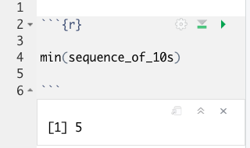
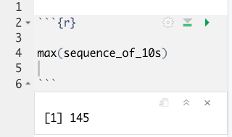
Bending objects to your will
Once we have created an object we can start to interact with it.
This includes passing our objects to other functions… Whoa!
Notes:
Objects are subject to same laws of programming we have learned so far.
We can provides objects as arguments for functions.

Slide 33
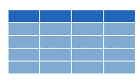


Dataframes: Beyond the Vector
Dataframe is the term for a table
Dataframes are composed:
Columns (Variables)
Rows (Observations)
Dataframes are objects and can be acted on like other objects
csv
xls
db
Notes:
Dataframe is the term we use for a table (think Excel spreadsheet).
Dataframes consists of columns (variables) and rows (observations). This is the tidy way to organize our data.
We can store dataframes as objects and perform actions on them like other objects.
We can get data into R from a variety of file formats (comma separated value files, excel spreadsheets, or directly from databases). This is the import part of data analysis.

Slide 34
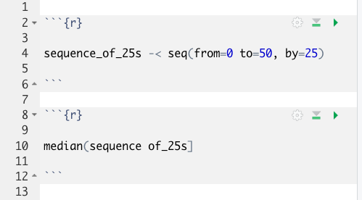
Your Turn #3
I’ve written some code to create a sequence from 0 to 500 in increments of 25 called sequence_of_25s. Ultimately I want to calculate the median value of this sequence. Unfortunately I’ve made some mistakes in my code and I am hoping you can help me find them.
Notes:
We will meet back together in a minute to see if we can fix this code together.

Slide 35
Tidyverse: R Packages for Data Science
A consistent way to organize data
Human readable, concise, consistent code
Build pipelines from atomic data analysis steps
Notes:
To import our CSV data, we need some additional data analysis tools. In this course, we will be leveraging the Tidyverse.
The Tidyverse is a modern set of tools for data analysis in R. It’s quickly becoming the de facto standard for doing data science with R.
The basic tenets of “tidy” data analysis include:
Data should be organized in a consistent, standardized way. Each row is an observation, and each column is a variable. This is a very common way to organize data in a spreadsheet and might sound familiar from how you may already organize data in tools like Excel.
Programming code that acts on the data should be consistent, concise, and mimic the narrative language as much as possible.
Each data analysis can be broken down into a series of atomic steps, such as “select this column” or ”arrange the data by the values in that column”. An arbitrarily complex data analysis can be broken down as a pipeline of atomic steps.

Slide 36
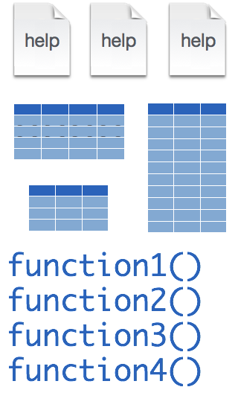
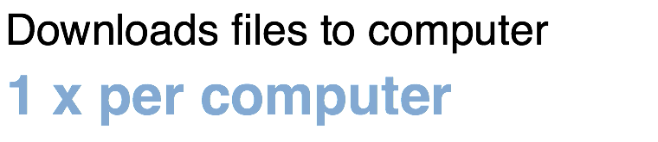
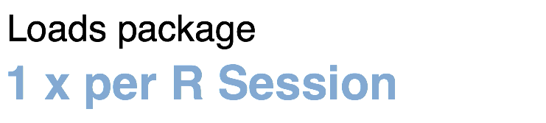
Installing and loading R packages
tidyverse
install.packages("tidyverse")
library("tidyverse")
Notes:
The Tidyverse is package (a collection of functions, data, and help documentation) that we can use to extend the functionality of R.
Packages need to be installed explicitly – with the command install.packages. So let’s say you want to install a package named “tidyverse”. You go to the R Console and type install.packages(“tidyverse”).
Each package you want to use needs to be installed only once on each computer. However, in order to use the functions or data in the package, you also need to load the package. This is done with the command “library”. So to enable all the functions in the “tidyverse” package, you type library(“tidyverse”). Packages remain loaded until you quit R. So every time you start a new R session you have to load each package that you want to use again.
On our RStudio Server, you won’t need to install any packages for this course (we have installed them for you). But at times in this course you’ll need to load packages.
So these are the first two R commands we’ve covered - install.packages and library.

Slide 37
Importing Data
Notes:
Now that we are familiar with how to create R Markdown documents we can begin the process of performing data analysis in R in earnest by importing a clinical data set.

Slide 38
The Data Analysis Pipeline
From R for Data Science (https://r4ds.had.co.nz/introduction.html)
Notes:
This diagram may look familiar, you saw it in the Welcome presentation.
The first step in the data analysis pipeline is to load the data into the environment so we can begin to tidy and transform that data.
In today’s course we will be using a de-identified data set consisting of COVID-19 laboratory test results from a microbiology lab. This data is stored as a CSV file.

Slide 39
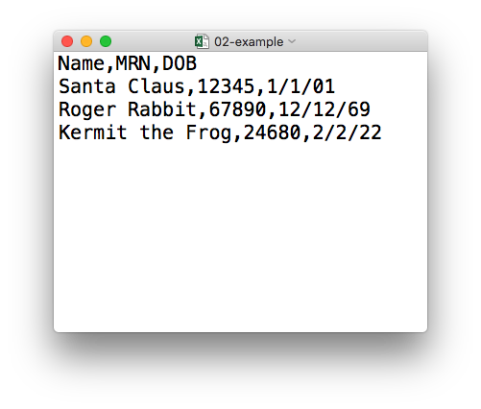
plain text (“flat”) file
csv
rectangular structure
header row
Notes:
So what’s a CSV file? CSV stands for comma-separated values.
** A CSV file is a plain text file, which means you can open it in a text editor and look at it.
Here we have a CSV file with the names, medical record numbers, and dates of birth for three fictional “patients”
** This data structure is called rectangular because it falls into rows and columns, where each row has the same # of columns, and each columns has the same # of rows.
** Also note that this particular CSV file has a header row that instead of data, has a descriptor of what kinds of data are found in each column. CSV files often but not always have such a header row.

Slide 40

read_csv()
data_frame <- read_csv(file_name)
csv
Notes:
Once, the Tidyverse package has been loaded via library, we can import CSV files using the read_csv() function.
Here is a template for how to use the read_csv function to create a data frame object from a CSV file.
You start with the name of a data frame object then you have this left-ward arrow then read_csv and then the file name in parentheses.

Slide 41
function
(does stuff)
data_frame <- read_csv(file_name)
Notes:
This code construct is exceedingly common in R, so I want to spend a few minutes exploring it together
Previously we talked about the absolute value and sequence functions.
read_csv() is also a function. Remember that functions are defined in packages. We loaded the Tidyverse package to be able to use the read_csv function.
You may be familiar with functions from math class. A function takes an input, say an ‘x’ value and returns an output, say a ’y’ value. Functions in computer programming also take inputs and return outputs. But the inputs and outputs here are the arguments and objects that exist within the context of a programming language.
For read_csv, the input is the file name of a CSV file; and the output is a data frame with the contents of the file.

Slide 42
function
(does stuff)
argument
(input)
data_frame <- read_csv(file_name)
Notes:
The input that goes into a function is called an argument. The argument to a function gets put in parentheses.
A function can have zero, one, or many arguments. If there is more than one argument, we use commas to separate them (remember the multiple arguments of the sequence function). We’ll see additional examples of this later.

Slide 43
object
(stores output)
function
(does stuff)
argument
(input)
data_frame <- read_csv(file_name)
Notes:
- The read_csv function outputs a data frame (think table), but if we want to *capture* that data frame inside of a named object, we need to specify that explicitly. It is a great idea to capture the output of a function in an object so it can be used as the input for other functions, for example to summarize or visualize the data in the named object.

Slide 44
object
(stores output)
function
(does stuff)
argument
(input)
data_frame <- read_csv(file_name)
assignment operator
(“gets”)
Notes:
To put the output of the read_csv function into a named object, we use the assignment operator.
The assignment operator is a smaller-than followed by a dash or minus and looks kind of like an arrow pointing left. It’s usually read as “gets.”

Slide 45
read_csv()
data frame to read data into
name of
CSV file
covid_testing <- read_csv("covid_testing.csv")
covid_testing
covid_testing.csv
csv
Notes:
Let’s put these pieces together to load our covid data set.
This line of code reads the “covid_testing object gets the output of the read_csv function on the covid_testing CSV file”.
You might notice that one of the objects is put in quotes and the other one isn't.
To be honest, quotes can be confusing. Names of objects such as data frames don't get quotes. In contrast, literal file names are always put in quotes. This is part of the grammar of coding (the syntax) in R that will become more familiar to you as you develop proficiency and comfort with the language.

Slide 46
Your Turn #4
In the MISC pane, select the folder:
“exercises”
Select the R Markdown file:
“01 - Importing and Exploring Data.Rmd”
In the Editor pane, follow the instructions to complete the exercise.
Notes:
One final your turn in this session.
In this exercise, we will ask you to open an R Markdown document and follow the instructions contained in that document to load and explore our data set.
We will meet back in 5 minutes to go over this exercise together.

Slide 47
Recap
Programming Language
Document Format
IDE
Packages extend the functionality of R. They need to be installed once per computer and loaded each session.
Functions do stuff. They accept Arguments to define parameters. We can store the output of functions in Objects using the assignment operator ( <- ).
Importing Data is the first step data analysis pipeline. read_csv() is a function from the tidyverse that we can use for importing data.
Notes:
To recap what we have covered in this introductory lesson.
We started by defining and differentiating R (the programming language) from Rstudio (the development environment) from R Markdown (the document format we use for reproducible data analysis).
In addition to learning to create and edit R Markdown documents we discussed some basic coding vocabulary including:
-Packages (such as the Tidyverse) which extend the functionality of R. We us the install.packages() function to install packages, and the library() function to load them into the environment.
-Functions do stuff on our behalf, they accept arguments, and we can store their output in named objects using the assignment operator
-Finally we discussed and practiced importing data using the read_csv() function from the tidyverse, and explored this data visually

Slide 48
What else?
Notes:
At the end of each lesson we have included a what else section to introduce you to ”what else” you may want to explore and learn about after completing this course.
This includes helpful hints, other functions in the Tidyverse, and exciting packages you may want to check out.

Slide 49
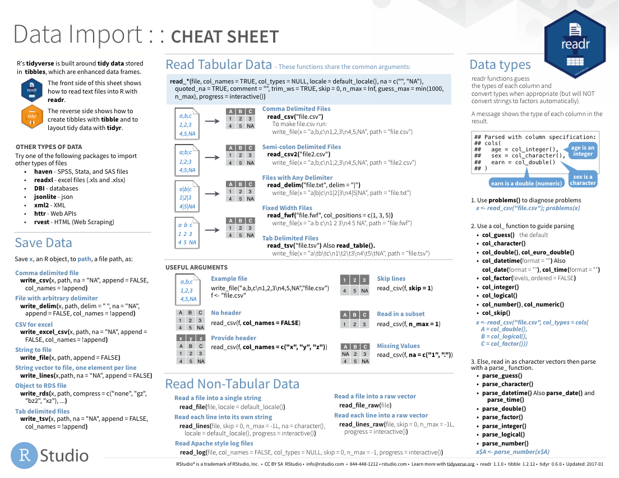
Notes:
The Data Import cheat sheet helps with the grammar of importing data including other file types and those with other separators (like pipes “|” instead of commas).
The Data Import cheat sheet is available on the RStudio website.

Slide 50
Notes:
There are a variety of other packages out there designed to deal with different file formats:
Readxl: Excel
Haven: SPSS, Stat, SAS files
Googlesheets
Rvest: scrape the web
Jsonlite: JSON data and APIs on the web

Slide 51
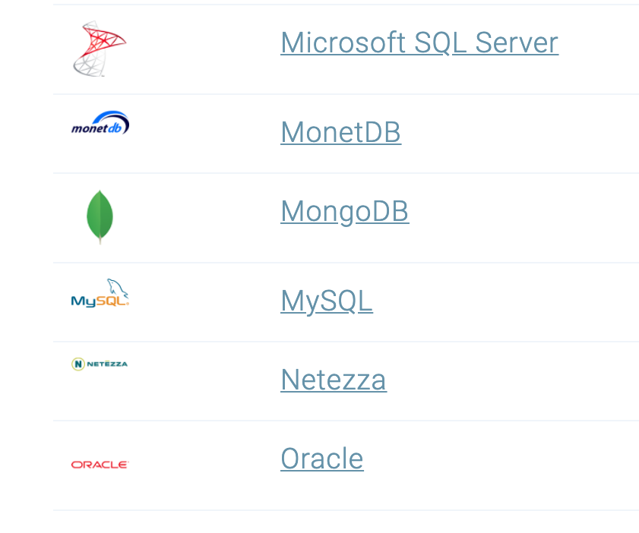
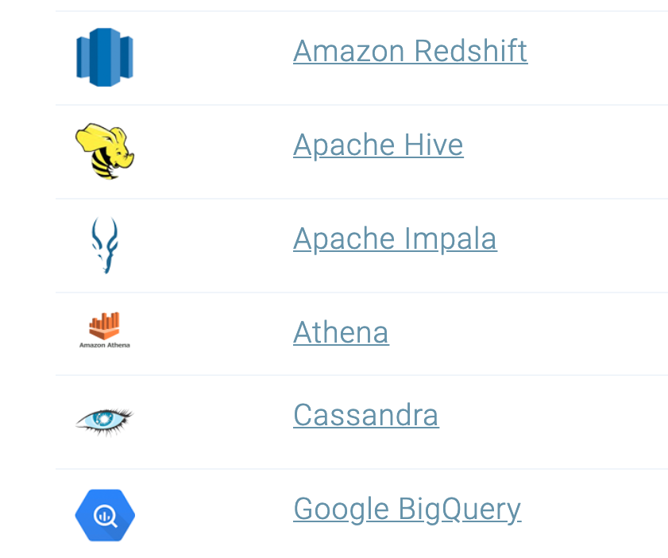
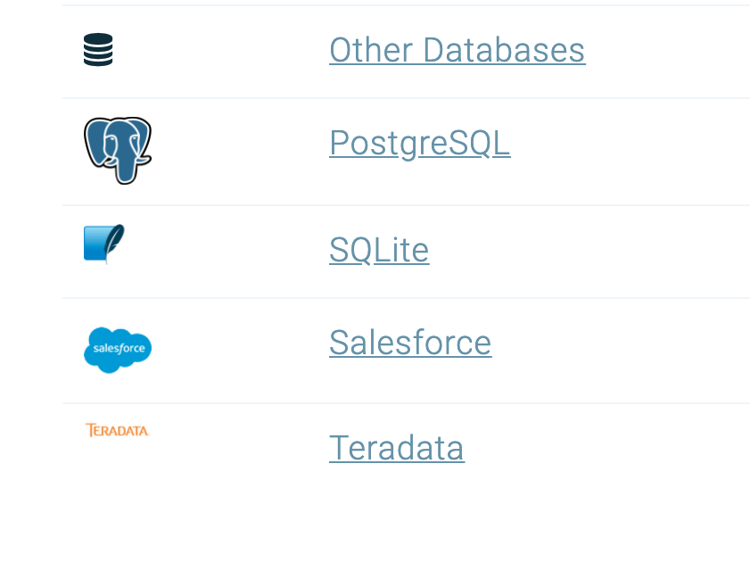
Databases
https://db.rstudio.com/databases/
Notes:
You can also connect to a variety of different databases directly in R to source your data.
If you use any of these, you may want to check out the tools to make database connections in R.

Slide 52





Notes:
In this lesson we practiced “knitting” our analysis to an HTML file.
In addition to HTML files, R Markdown documents can be “knitted” into a number of additional formats including PDF, Microsoft Word, PowerPoint, and even interactive dashboards. We will look at dashboards in greater detail later in the course.

Slide 53
R Interface to Python
```{python}
import pandas
covid_testing.info()
```
Notes:
The reticulate package provides an interface between R and python.
This means, you can mix code chunks written in R with code chunks written in Python.
R does many things really well, but no programming language is perfect for all tasks. It is great that R gives us tools to mix and match languages in different code chunks in situ.
For those of you new to coding, we recommend focusing on a single language to develop proficiency before moving on to another language. This will shorten the learning curve for your first and future languages.

